Slide 1
CSE326 PROJECT WORK
Name-Yajur Sharma
Roll-RK20UDA45
REG-12006672
GROUP-1
Project-Movie Booking Management System(Using HTML,CSS,JS)
Submitted To- Goutam Majumdar Sir
Date of Starting-15/04/21
Duration span-15/04/21 --- 23/05/21
Date of Submission-24/04/21

Slide 2
Overview-
The project objective is to book cinema tickets in online. The Ticket Reservation System is an Internet based application that can be accessed throughout the Net and can be accessed by anyone who has a net connection. This application will reserve the tickets. This online ticket reservation system provides a website for a cinema hall where any user of internet can access it. User is required to login to the system and needs a credit card for booking the tickets. Tickets can be collected at the counter and Watching movies with family and friends in theatres is one of the best medium of entertainment after having a hectic schedule. But all this excitement vanishes after standing in hours in long queues to get tickets booked. The website provides complete information regarding currently running movies on all the screens with details of show timings, available seats. Ticket reservations are done using credit card and can be cancelled if needed. Our online tickets reservation system is one of the best opportunities for those who cannot afford enough time to get their tickets reserved standing in long queues. People can book tickets online at any time of day or night. Our reservation system also provides option to cancel the tickets which are reserved previously.

Slide 3
Introduction-
Welcome to newly designed website movie ticket booking is a faster, cleaner and a tad more personal website, specially designed to make your booking experience better. Log on, navigate and find out for yourselves and if time permits leave your valuable feedback.
Customers may view the contents of any movie show at any time and may book any movie ticket as needed. The program automatically calculates the subtotal and grand total. When a visitor decides to finally book the ticket, the order information including the buyer's name, address and billing instruction is stored in the database securely and payment has been made.
The combo booking is also provided at the time of booking the ticket and there’s a wonderful facility of delivering the combos at your seat when you are watching the movie.
You need to register a new user whenever you have first visited or site then for future it will be stored in our database permanently and you can book you movie ticket at any time you want with this username and password.

Slide 4
System Requirements-
2. SYSTEM REQUIREMENT
2.1 Hardware Specification
Server:
Processor-7th generation i5
RAM-128MB (min)
Hard disk-20GB
Customer:
Processor-7th generation i5
Ram-128MB (min)
Hard disk- 20GB
2.2 Software Specification
Platform - Windows 8,10
Front end - Html, Css

Slide 5
Front End
HTML : Hypertext Markup Language (HTML) is the standard markup language for creating web pages and applications. Each page contains a series of connections to other pages called hyperlinks. HTML describes the structure of a web page semantically and originally included cues for the appearance of the document. HTML elements are delineated by tags, written using angle brackets. Tags such as <img> and <input/> introduce content into the page directly. Others such as <p>….</p> surround and provide information about document text and may include other tags as sub-elements. Browsers do not display the HTML tags, but use them to interpret the content of the page. HTML code ensures the proper formatting of text and images so that your Internet browser may display them as they are intended to look. Without HTML, a browser would not know how to display text as elements or load images or other elements. HTML also provides a basic structure of the page, upon which Cascading Style Sheets are overlaid to change its appearance.
CSS: Cascading Style Sheets (CSS) is a style sheet language used for describing the presentation of a document written in a markup language. CSS is designed primarily to enable the separation of presentation and content, including aspects such as the layout, colors, and fonts This separation can improve content accessibility, provide more flexibility and control in the specification of presentation characteristics, enable multiple HTML pages to share formatting by specifying the relevant CSS in a separate .css file, and reduce complexity and repetition in the structural content.

Slide 6
Conclusions-
This project is developed successfully and the performance is found to be satisfactory. This project is designed to meet the requirements of assigning jobs. It has been developed in CSS and the HTML and been built in JS keeping in mind the specifications of the system.
The user will be able to book the ticket using this website. The relationship between company manager, employee, and customer satisfy a good communication to complete ticketing process.
We have designed the project to provide the user with easy retrieval of data, details of theatre and necessary feedback as much as possible. In this project, the user is provided with a website that can be used to book movie tickets online. To implement this as a web application we used php as the technology. JS has advantages such as enhanced performance, scalability, built- in security and simplicity. To build any web application using HTML AND CSS we need a programming language such as C++ and so on. For front end we used HTML and CSS.

Slide 7
Future Scope
· In future our job management system will have extra facilities and more companies for more employees.
· It will grant more easy access.
· We are going to include recommendation system to this project so it will be helpful for the user to search and apply for jobs as they wish.

Slide 8
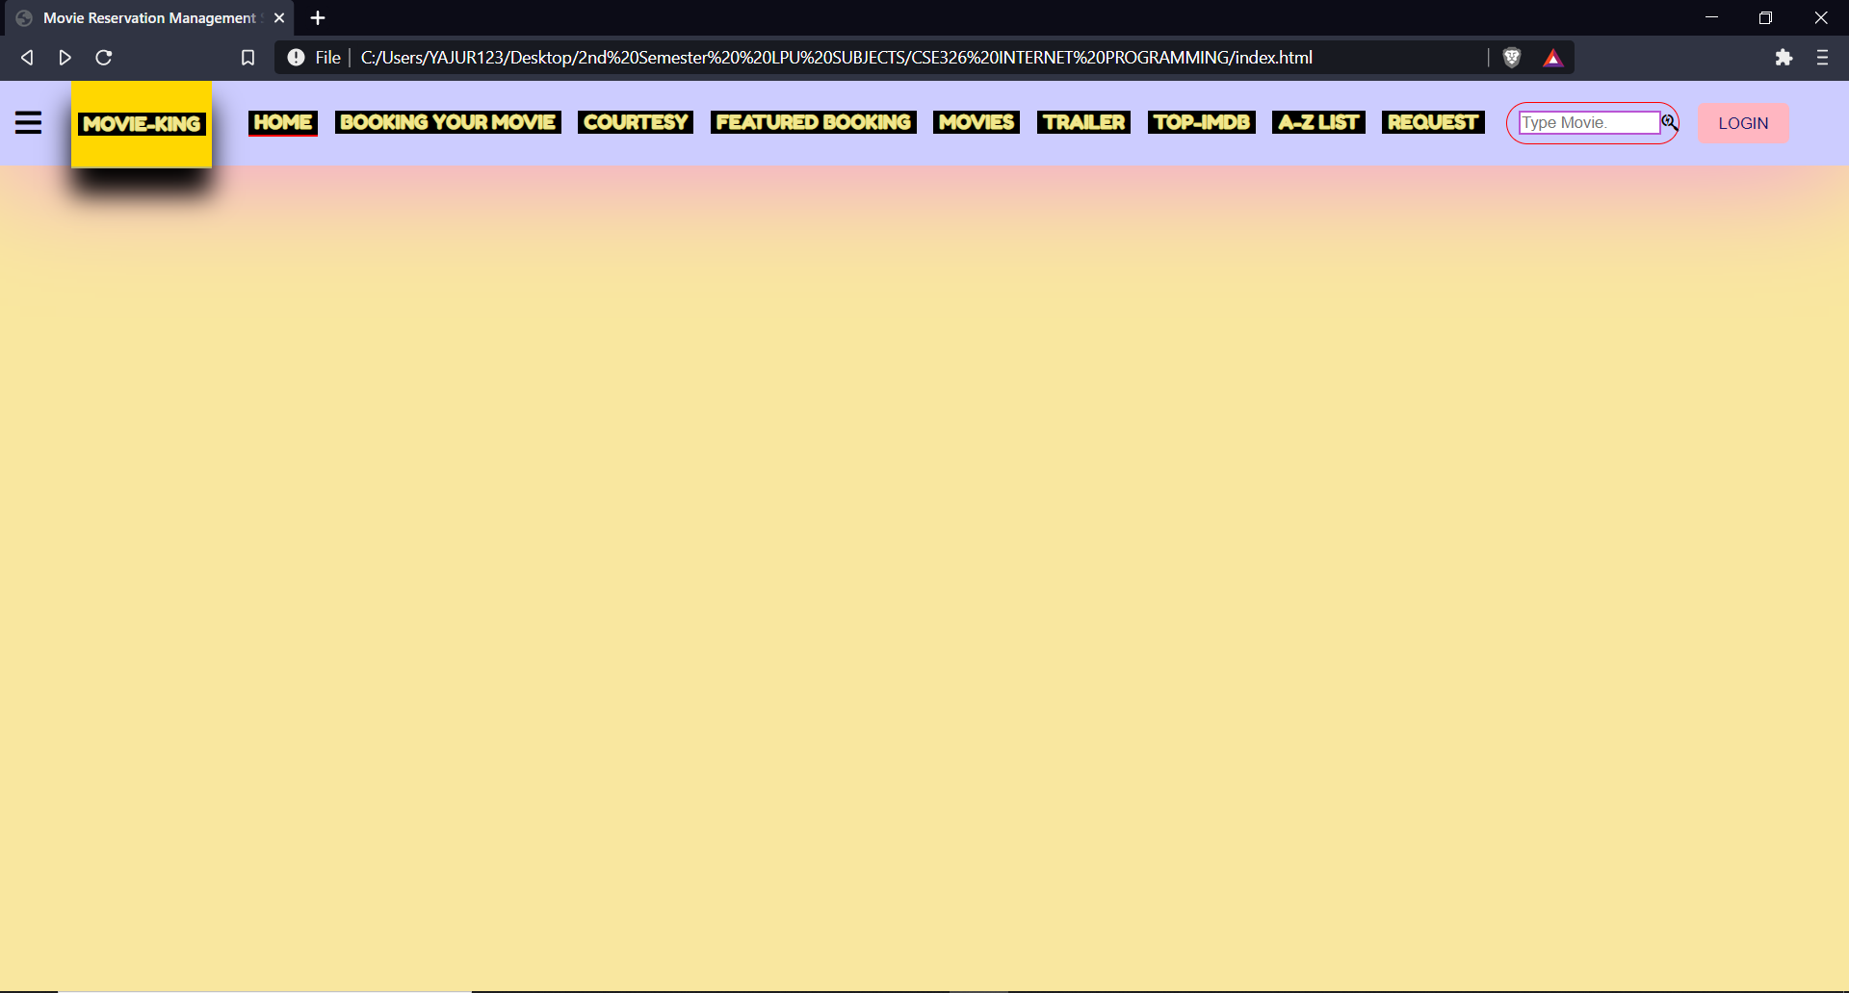
SIMULATION SCREENSHOTS

Slide 9
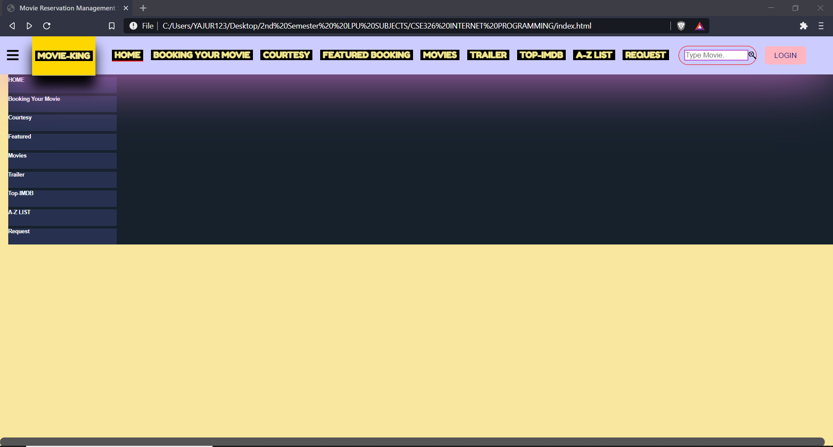
SIMULATION SCREENSHOTS

Slide 10
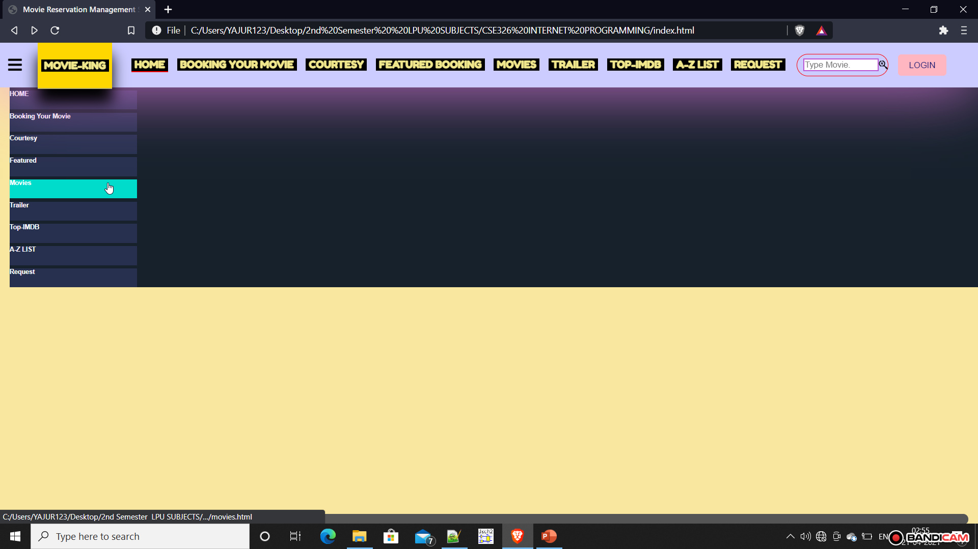
SIMULATION SCREENSHOTS

Slide 11
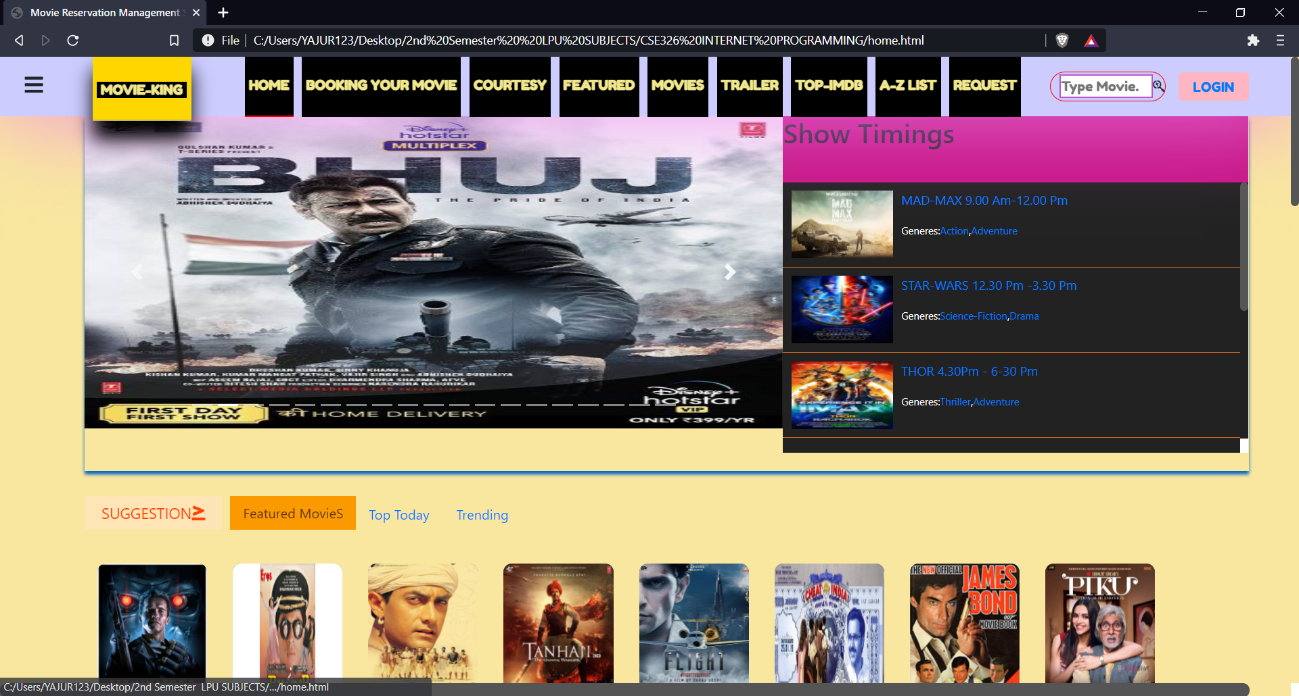
SIMULATION SCREENSHOTS

Slide 12
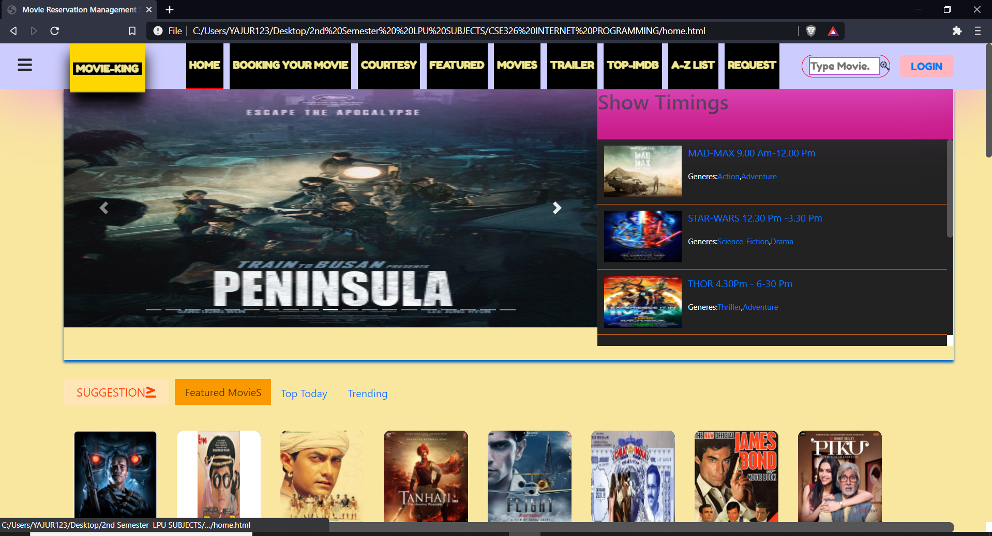
SIMULATION SCREENSHOTS

Slide 13
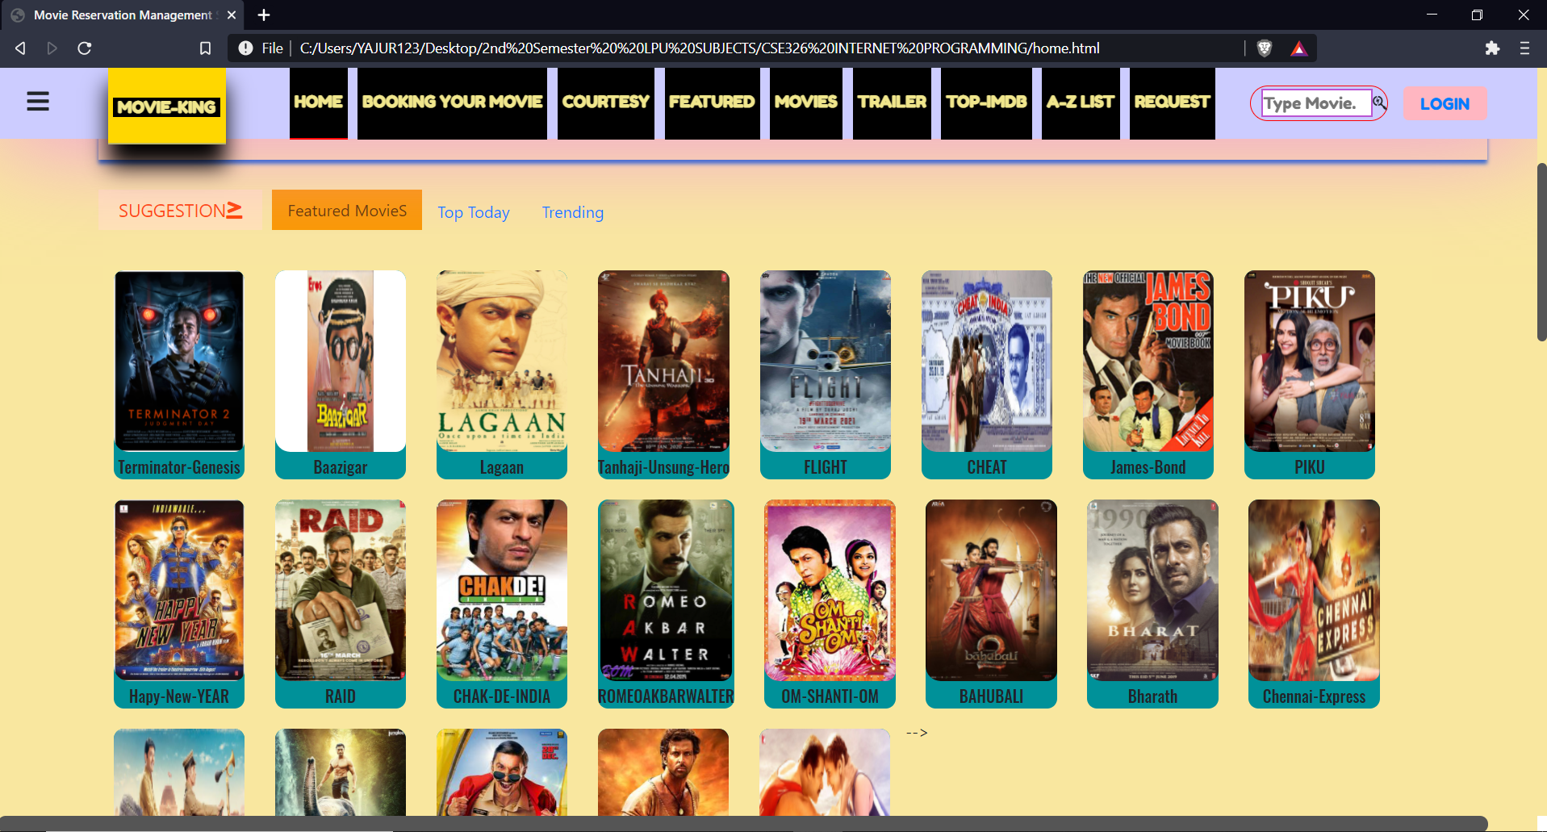
SIMULATION SCREENSHOTS

Slide 14
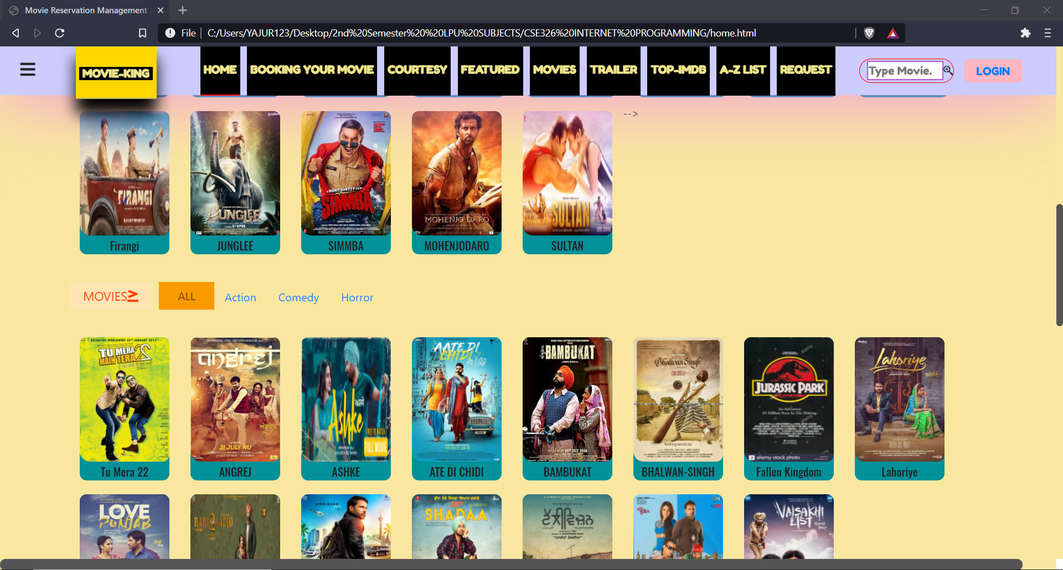
SIMULATION SCREENSHOTS

Slide 15
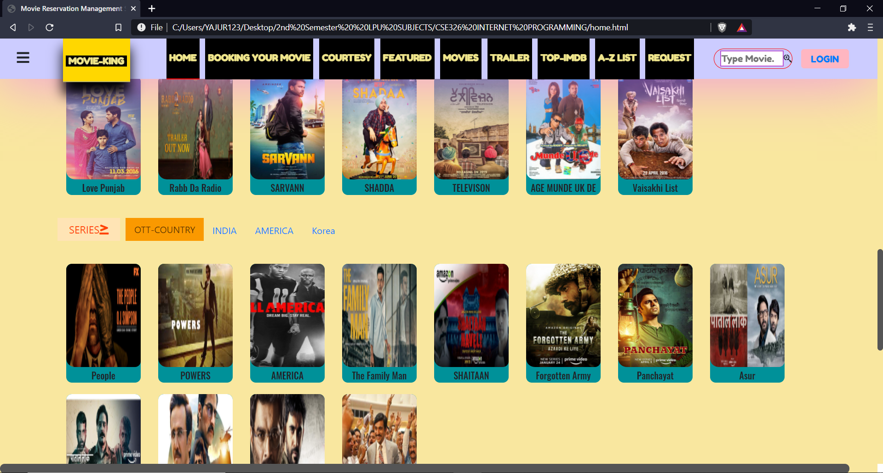
SIMULATION SCREENSHOTS

Slide 16
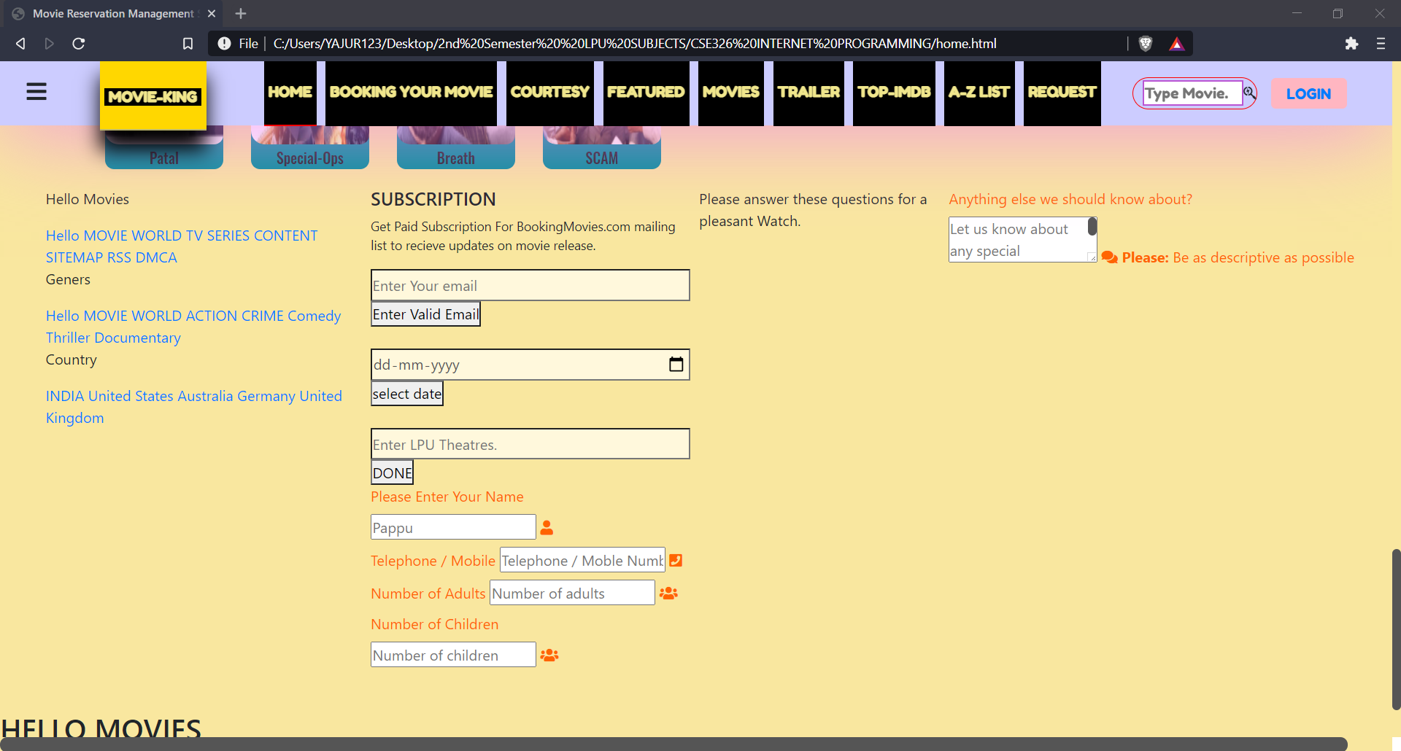
SIMULATION SCREENSHOTS

Slide 17
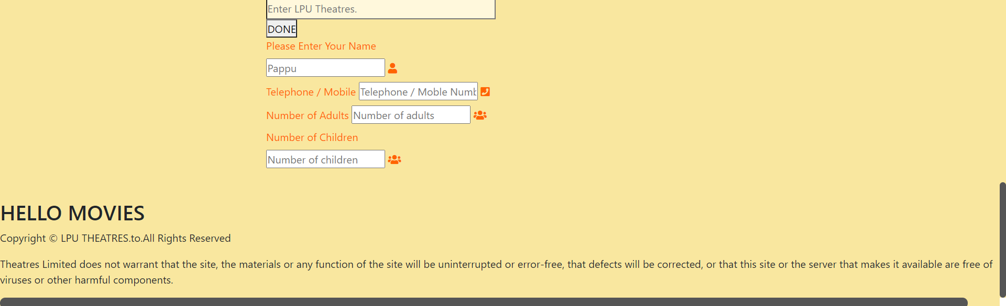
SIMULATION SCREENSHOTS

Slide 18
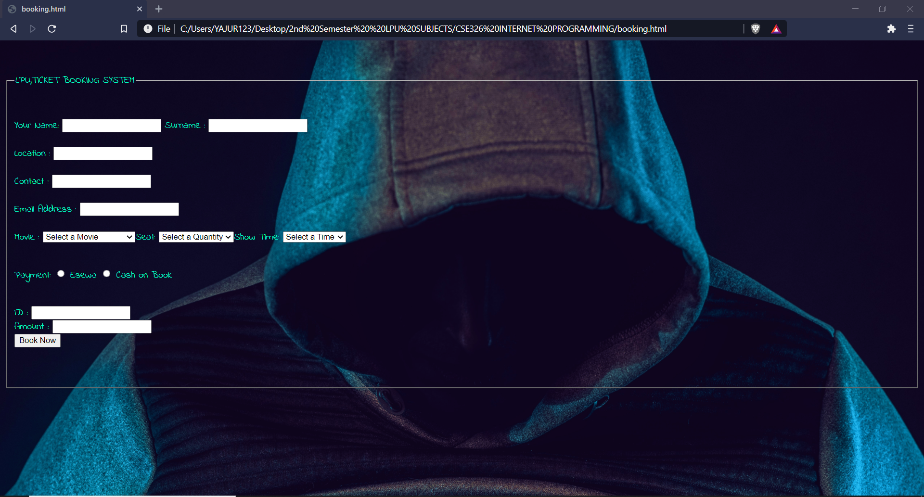
SIMULATION SCREENSHOTS

Slide 19
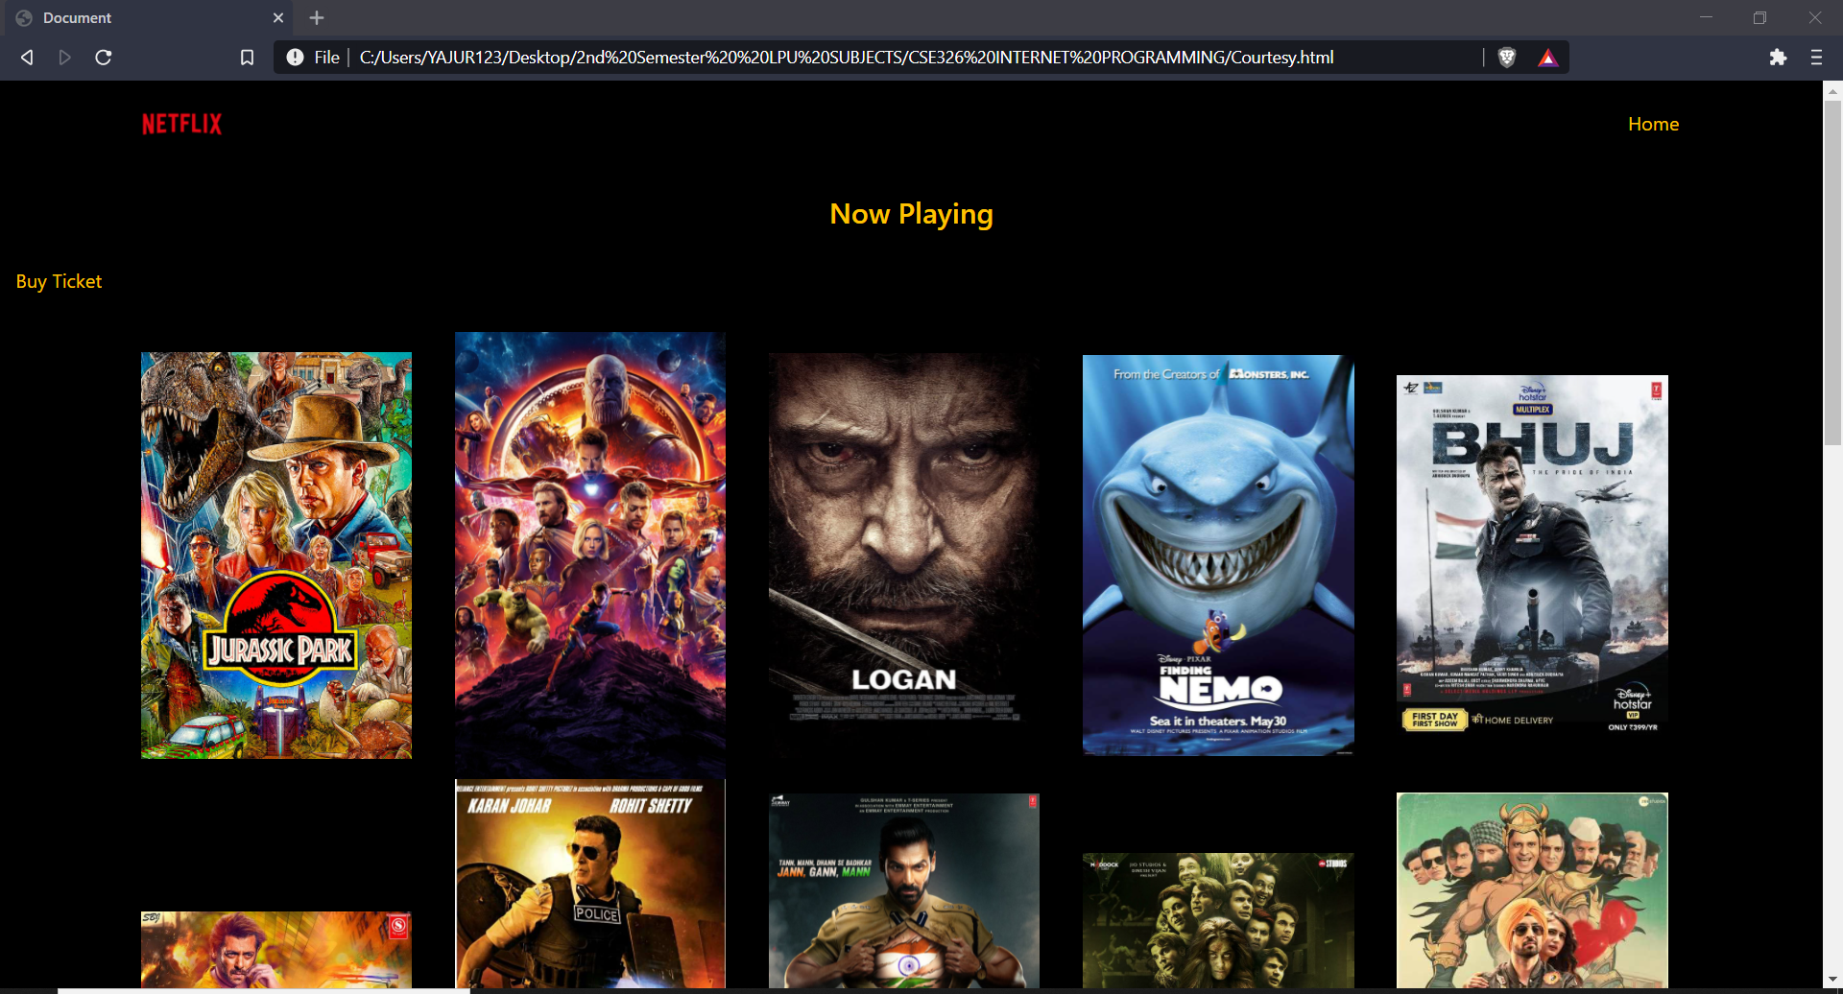
SIMULATION SCREENSHOTS

Slide 20
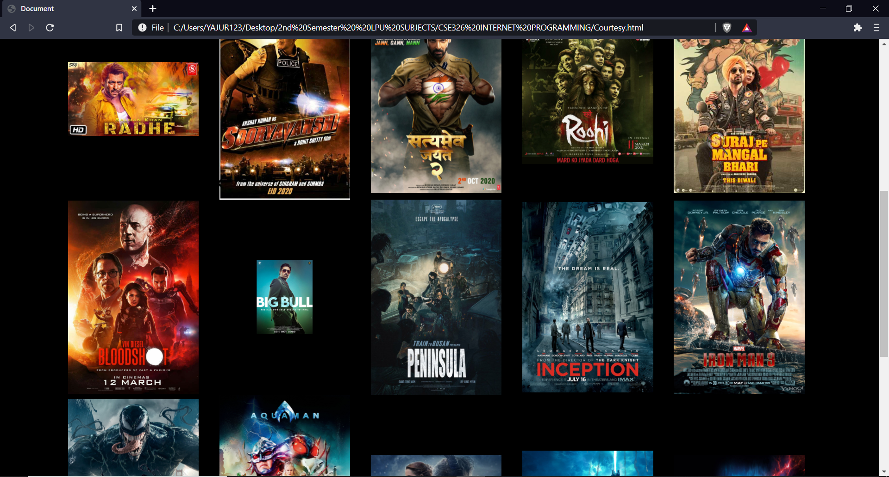
SIMULATION SCREENSHOTS

Slide 21
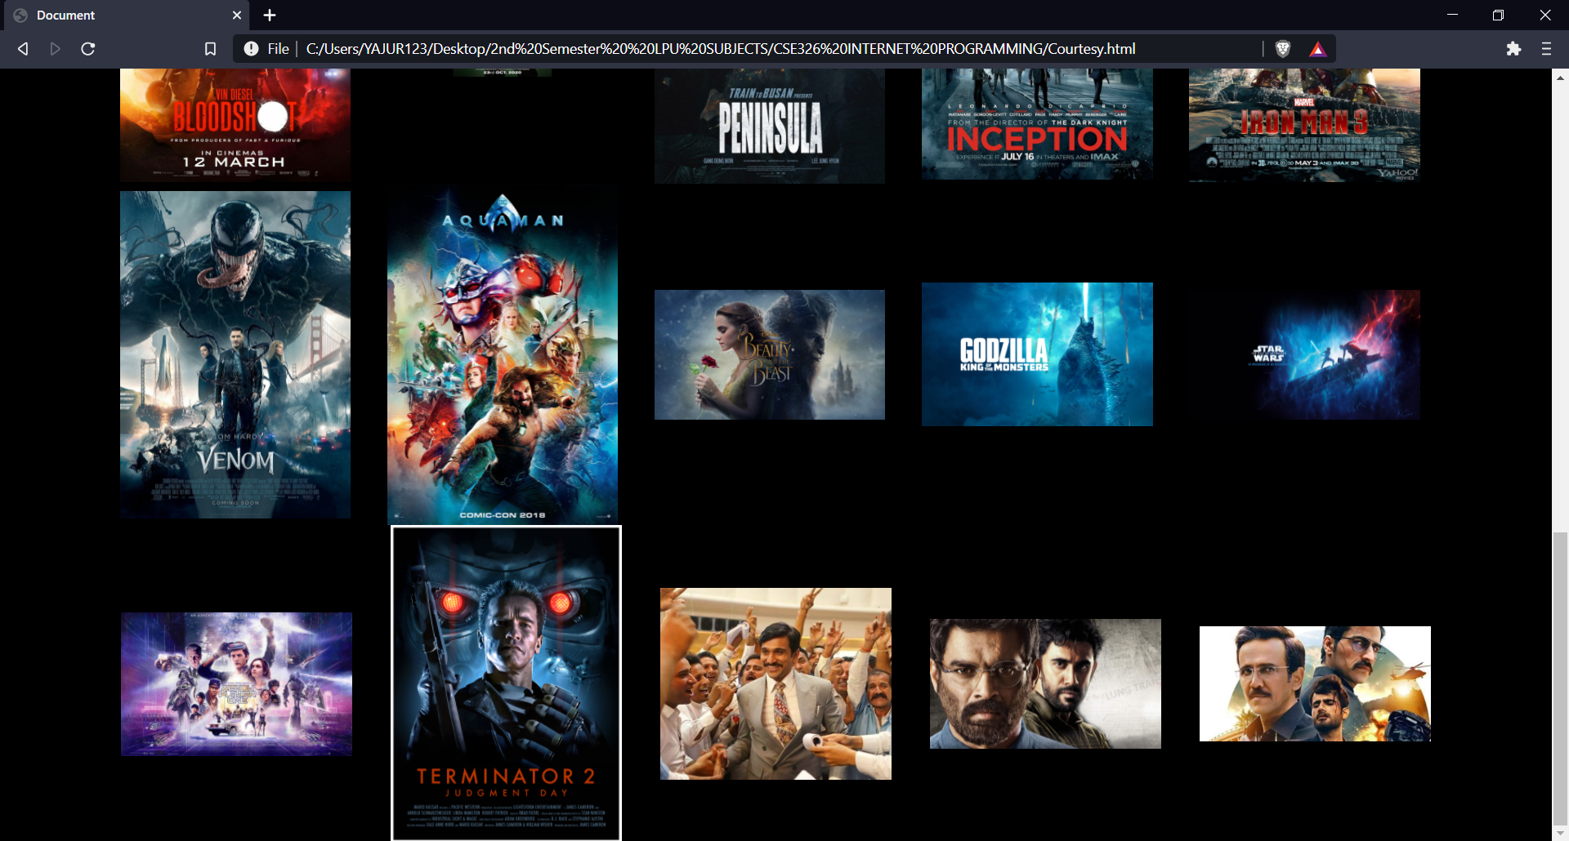
SIMULATION SCREENSHOTS

Slide 22
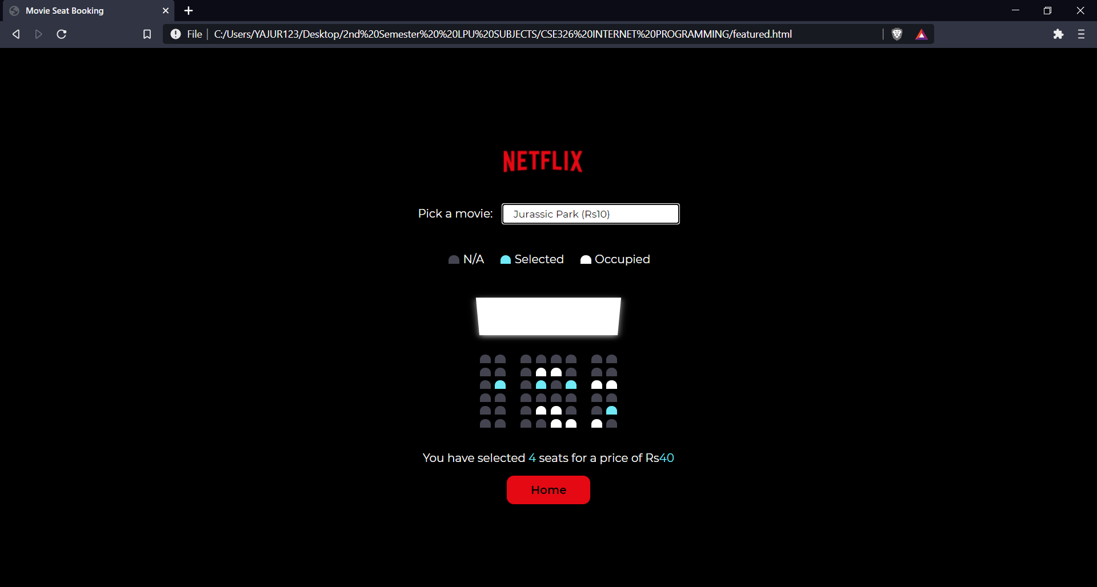
SIMULATION SCREENSHOTS

Slide 23
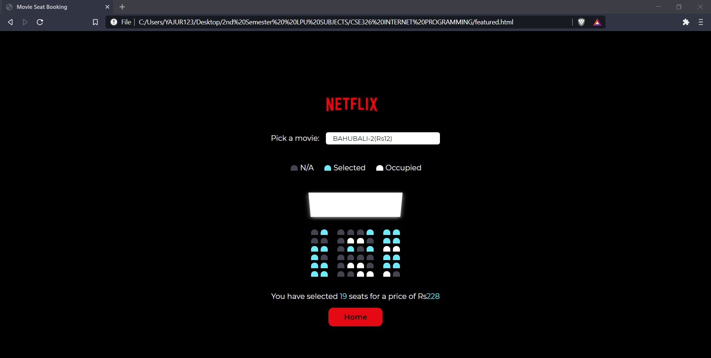
SIMULATION SCREENSHOTS

Slide 24
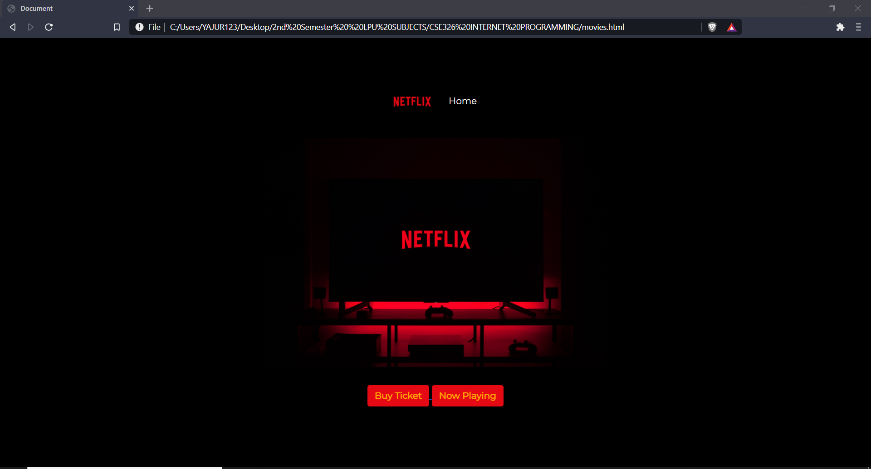
SIMULATION SCREENSHOTS

Slide 25
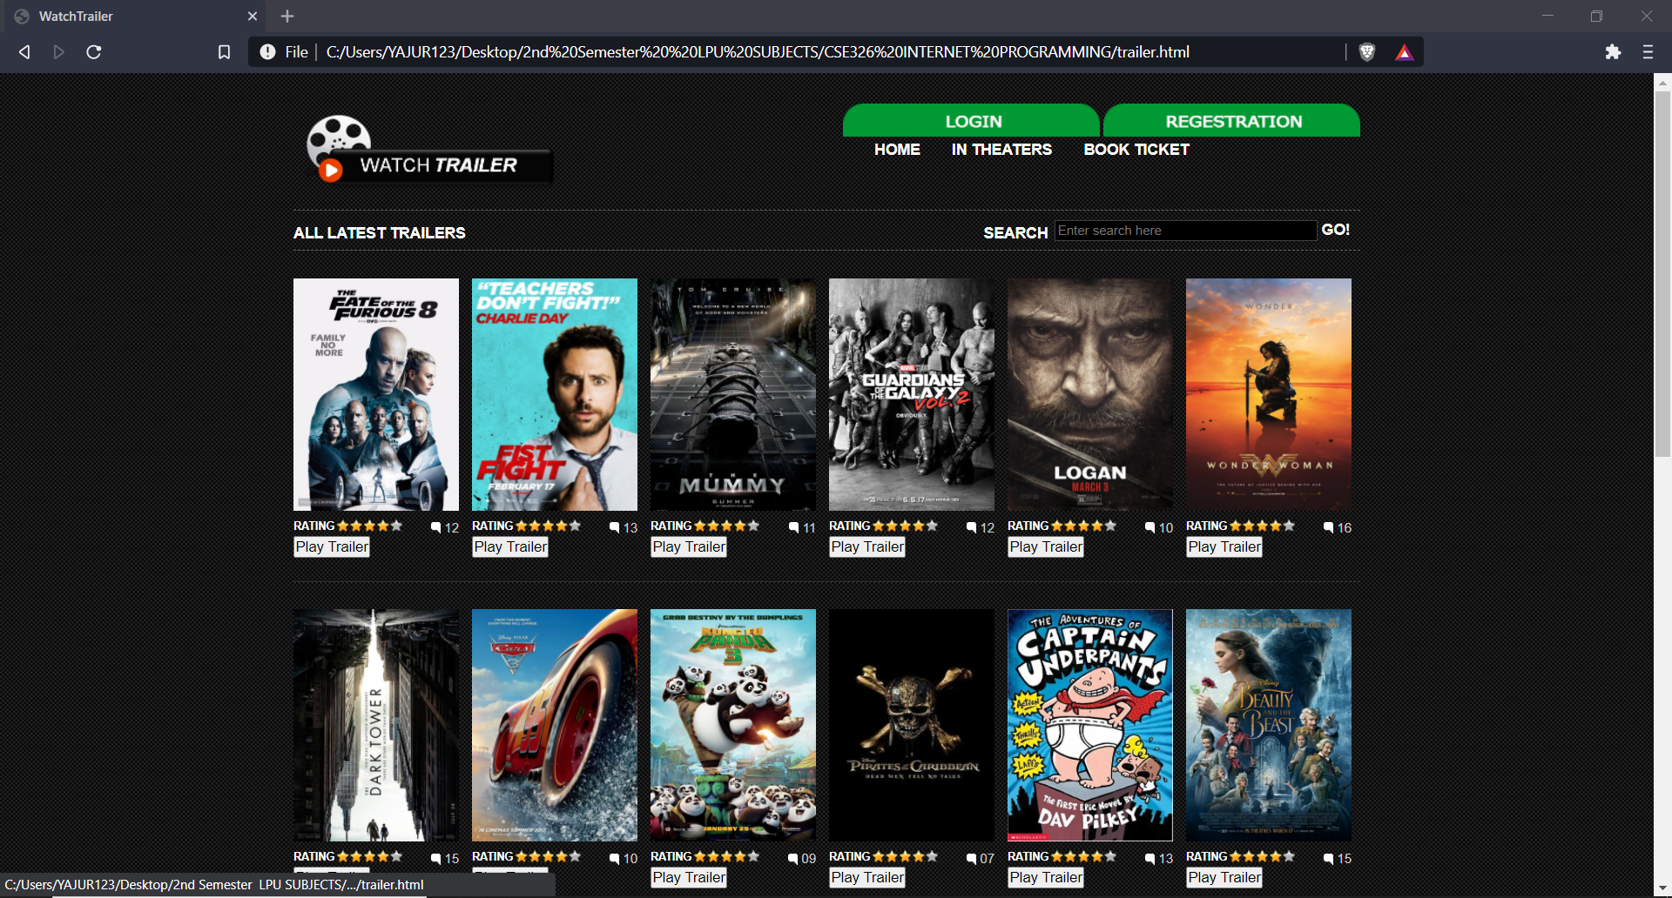
SIMULATION SCREENSHOTS

Slide 26
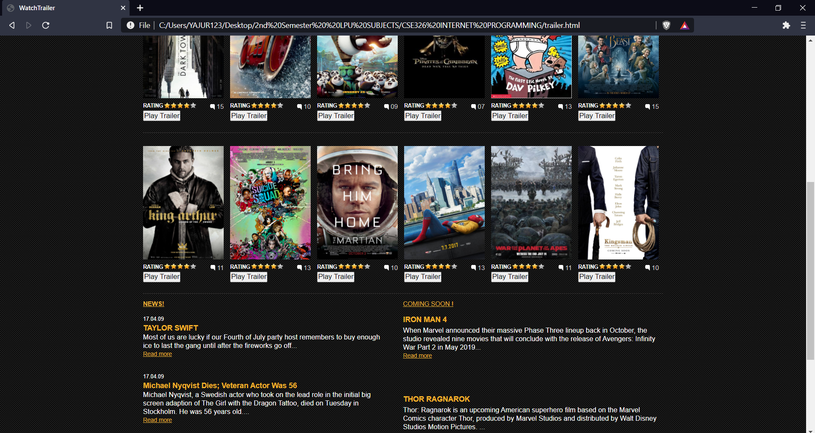
SIMULATION SCREENSHOTS

Slide 27
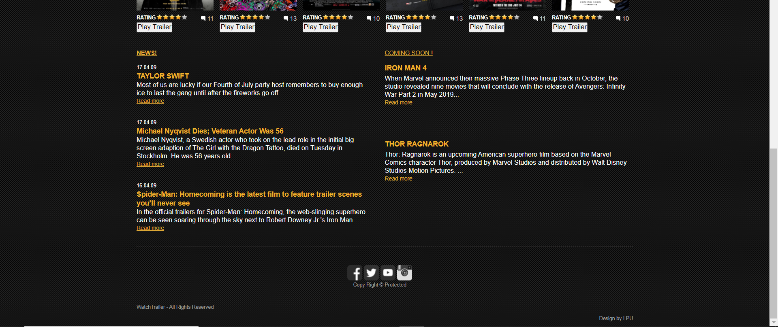
SIMULATION SCREENSHOTS

Slide 28
